Slide 1

Data Analytics Portfolio: Strategic Insights Across Finance, E-Commerce, Entertainment & Cybersecurity
End-to-End Data Pipeline Development | SQL Analysis | Predictive Modeling | Business Intelligence

Slide 2
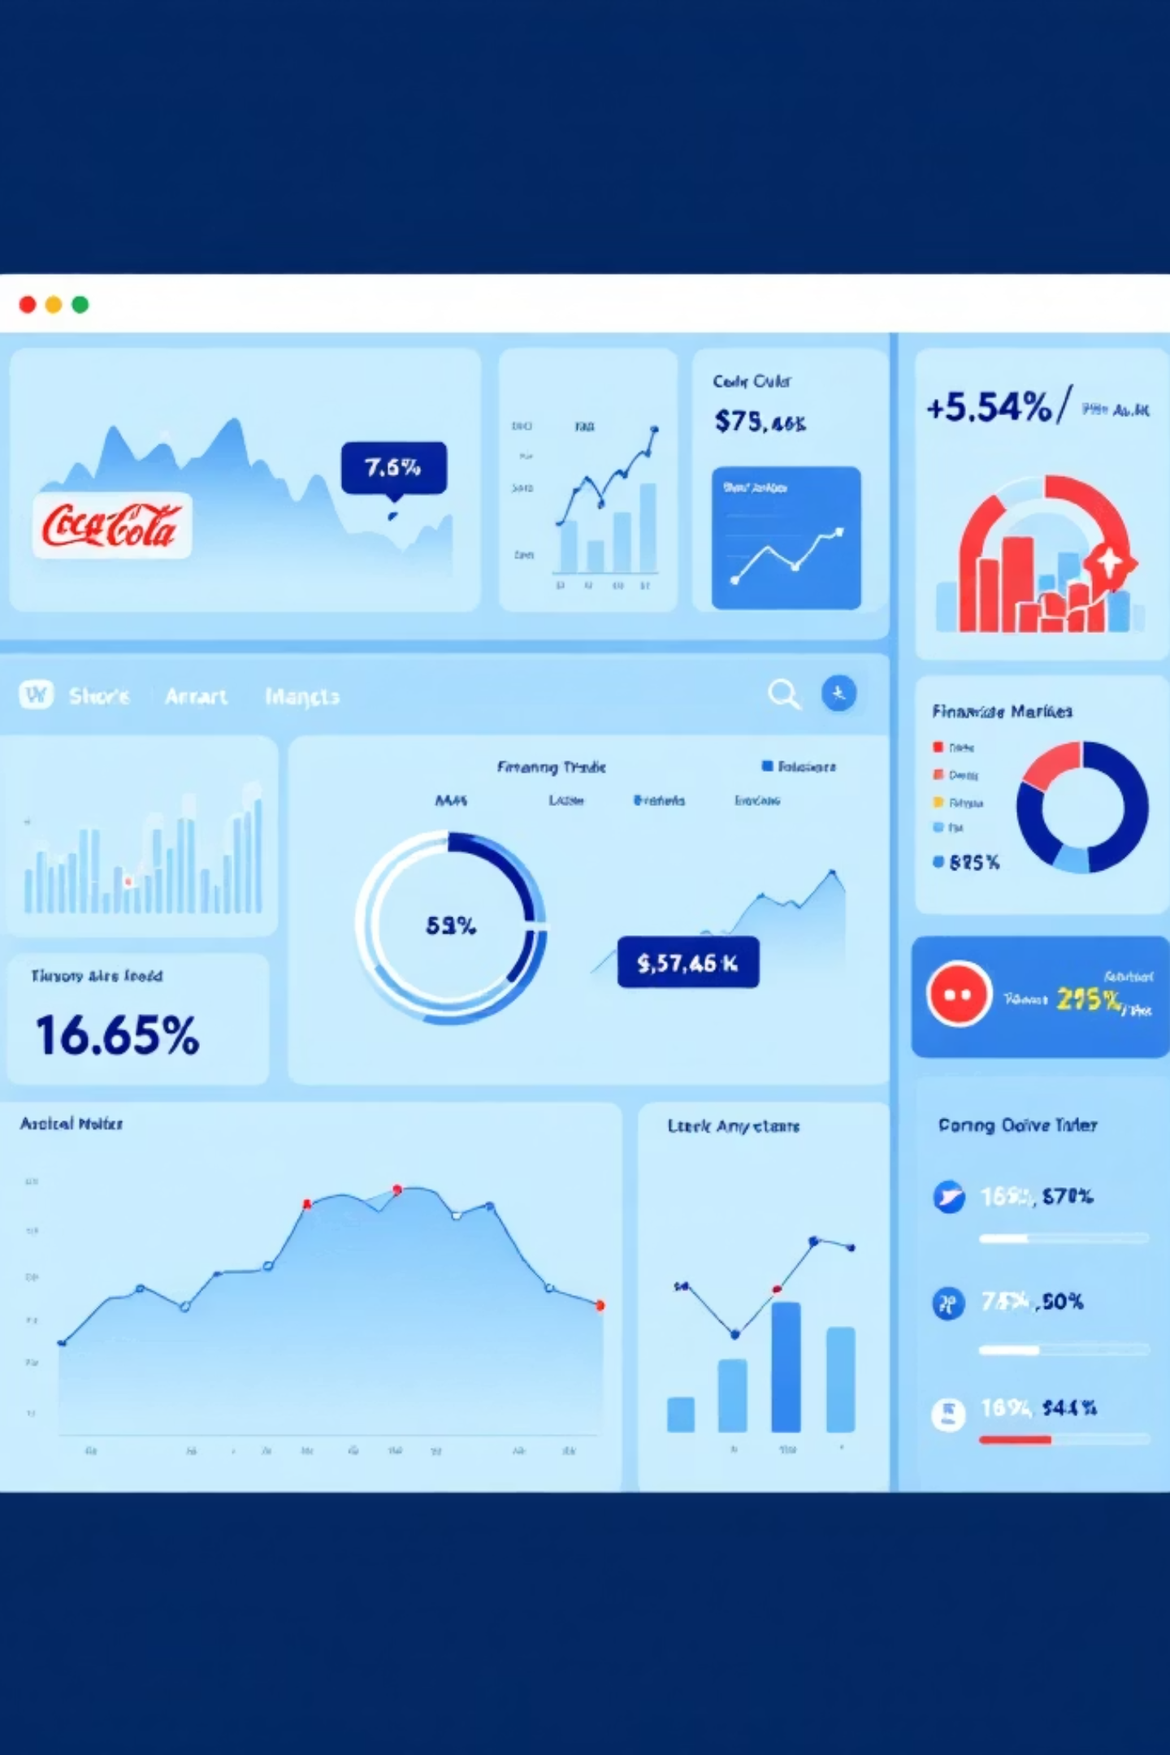
Project 1: Coca-Cola Stock Analysis – Volatility & Trading Patterns
Problem Statement
Data Pipeline
Identify historical stock volatility patterns and trading volume correlations to optimize investment strategy and timing
15,311 historical records (1962-2025) | MySQL integration | OHLC pricing standardization | Live yfinance API updates
Key Metrics
SQL Analysis
Correlation (Price-Volume): 0.456
MA_20/MA_50 trend indicators
Daily volatility (20-day rolling std)
Monthly volume aggregation
Year/Month grouping
AvgPrice calculation: (O+H+L+C)/4
Models
Key Insight
Linear Regression (MAE: 0.116)
Random Forest (MAE: 14.67)
LSTM Neural Network (MSE: 0.00051 - best)
Monthly volume spikes reveal high-liquidity periods; LSTM captures non-linear price dynamics with 99.95% accuracy on normalized scale
Business Impact
Enables optimal entry/exit point identification; supports portfolio positioning during high-volume trading windows

Slide 3

Project 2: Laptop Pricing Intelligence – Feature-Driven Market Segmentation
Problem Statement
Data Cleaning
Analyze Indian laptop market pricing dynamics across 23 technical specifications to identify feature premiums and optimal positioning
1,275 laptops | Null validation on Company/Product/Price | Duplicate removal | EUR→INR conversion (109.99 rate) | Feature engineering: Pixels, PPI_proxy, TotalStorage
EDA Findings
Models
5 price bands identified (Budget to Ultra) | Brand distribution across segments | Type positioning analysis
Ridge (R²: 0.748) | Lasso (R²: 0.751) | Random Forest (R²: 0.812) | XGBoost (R²: 0.851 - best)
Top Features
Market Segmentation
RAM configuration | Storage type (SSD vs HDD) | Display resolution (IPS panels) | CPU frequency | Screen size
Budget: <500€ | Mid: 500-1000€ | Upper-Mid: 1000-1500€ (highest volume) | Premium: 1500-2500€ | Ultra: >2500€
Strategic Recommendation
Focus Upper-Mid tier expansion with SSD/16GB RAM bundles; highest market volume and profitability potential

Slide 4

Project 3: Netflix Content Strategy – Regional Genre Optimization
Problem Statement
Data Cleaning
Evaluate streaming platform content library composition to optimize acquisition strategy and regional genre targeting across global markets
8,790 titles | Genre explosion (multi-tag parsing) | Director standardization (Not Given handling) | Date parsing (year/month/day extraction) | Duration parsing (movies vs TV seasons)
Content Composition
Seasonal Patterns
6,126 Movies (69.7%) | 2,664 TV Shows (30.3%) | Preference for feature films as primary engagement vehicle
Peak content additions: September-October | Monthly trend analysis reveals strategic release windows
Regional Insights
Models
India: Comedy dominance | USA: Diverse genre mix | Top countries: United States, India, United Kingdom, Canada, Japan
Logistic Regression (Movie/TV: 100% accuracy) | Random Forest (100% accuracy) | Gradient Boosting (Rating prediction: 51% accuracy)
Feature Importance
Strategic Value
Movie duration (80.9%) | Country (3.0%) | Release year (2.7%) | Rating (1.9%)
Aligns release calendars with high-growth months; identifies content gaps in top-performing countries for strategic acquisitions

Slide 5

Project 4: Instagram Fake Account Detection – ML-Powered Botnet Identification
Problem Statement
Data Overview
Develop machine learning classification model to distinguish genuine from fraudulent social media accounts, enabling automated botnet detection and platform security
576 training accounts | 120 test accounts | Perfectly balanced dataset (50/50 fake/genuine) | 12 behavioral features
Feature Engineering
EDA Insights
username_num_ratio | fullname_num_ratio | fol_ratio (followers/following) | profile_pic presence | external_url | is_private | posts | followers | follows
Fake accounts lack profile pictures (key differentiator) | Abnormal follower distributions (very low or unusually high) | Username numeric ratio indicates auto-generation
Models
Test Performance
Logistic Regression (91.4% accuracy) | Decision Tree (90.5% accuracy) | Random Forest (93.1% accuracy - best)
Precision: 0.95 (genuine) / 0.90 (fake) | Recall: 0.90 (genuine) / 0.95 (fake) | F1-Score: 0.92-0.93
Top Predictors
Business Impact
Followers (25.9%) | Posts (18.1%) | Username numeric ratio (13.1%) | Follower-following ratio (11.0%) | Profile picture (10.9%)
Automated detection of fraudulent accounts; protects platform integrity and user trust; enables proactive botnet mitigation

Slide 6


Technical Skills & Expertise
SQL & Data Engineering
Python & Machine Learning
Complex joins, aggregations, database pipeline construction, MySQL optimization, data quality assurance
Random Forest, XGBoost, LSTM, Logistic Regression, feature engineering, predictive analytics, scikit-learn, TensorFlow
Data Visualization & BI
Statistical Analysis
Dashboard design, Tableau/matplotlib/seaborn, strategic insight communication, trend analysis, KPI tracking
Correlation analysis, hypothesis testing, EDA, time-series analysis, classification metrics, model evaluation
Experienced data analyst with demonstrated track record across finance, e-commerce, entertainment, and cybersecurity domains. Proven ability to transform raw data into strategic insights through end-to-end pipeline development, SQL analysis, and predictive modeling.
Available for: Data Analyst | Business Intelligence | Analytics Engineer | Data Science positions

Slide 7
Project 1: Coca-Cola Stock Performance Analysis
Objective
SQL Pipeline
Key Insight
Analyse historical stock trends to identify volatility patterns and trading volume correlations for investment strategy optimisation.
Built structured MySQL environment integrating live datasets with standardised date formats and floating-point precision for OHLC pricing data.
Monthly volume aggregation revealed long-term growth trajectories and specific high-liquidity periods for strategic portfolio positioning.
Strategic Value: Enables identification of optimal entry/exit points based on historical volume spikes and price movements.

Slide 8

Technical Approach: Data Engineering Pipeline
Constructed a robust data pipeline integrating live updated datasets into a structured MySQL environment. Standardised date formats and handled floating-point precision for Open, High, Low, and Close prices.
Calculated AvgPrice using (Open+High+Low+Close)/4 to normalise daily fluctuations. Aggregated volume and price by Year/Month to reveal long-term growth trends and specific high-liquidity periods.
Visualization: Dashboard featuring "Stock Price Trends" and "Trading Volume Trends" for temporal analysis.

Slide 9

Project 2: Laptop Pricing Market Intelligence
Analytical investigation into Indian market laptop pricing dynamics, identifying hardware features driving price premiums across 23 technical specifications.
Methodology: Systematic null checks on 'Company', 'Product', and 'Price' fields with duplicate record removal. Distribution analysis by TypeName and hardware brand revealed market segmentation patterns.

Slide 10



Market Segmentation Analysis: Key Findings
Pricing Tier Breakdown
Storage Impact
Display Premiums
Market segmented into Budget, Mid, Upper-Mid, Premium, and Ultra bands based on feature configurations.
SSD versus HDD storage in specific RAM buckets significantly correlates with price premiums.
High-resolution screens with IPS panels act as primary price drivers for "Premium" and "Ultra" categories.
Strategic Value: Provides manufacturers with feature bundle pricing roadmaps and identifies optimal positioning in high-volume "Upper-Mid" tier with SSD/16GB RAM configurations.

Slide 11

Business Impact & Strategic Recommendations
The laptop pricing intelligence project delivered actionable market insights for competitive positioning. Analysis revealed that high-resolution displays serve as primary differentiators for premium categories, whilst SSD storage configurations in mid-tier segments capture maximum market volume.
Strategic Recommendation: Focus on "Upper-Mid" tier expansion with SSD/16GB RAM bundles, as this segment demonstrates the highest market volume and profitability potential.

Slide 12

Project 3: Netflix Content Strategy Analytics
Streaming platform analytics evaluating content library composition to optimise acquisition strategy and regional genre targeting across global markets.
Pipeline Architecture: Exploded genre tags to perform granular analysis, standardised "Not Given" director entries, and leveraged SQL JOINs between titles and genres tables to map country-specific preferences and director activity.
Identified monthly trend patterns and regional genre matrices enabling data-driven content acquisition decisions.

Slide 13
Netflix Content Strategy: Key Analytics Insights
Content Composition
Seasonal Patterns
Regional Preferences
Quantified "Movie" versus "TV Show" counts, revealing platform-wide preference for feature films as primary engagement vehicle.
Identified monthly "Yearly Trend of Additions" to pinpoint peak content release windows for maximum viewership impact.
Mapped top genre-country combinations exposing differentiation opportunities in India ("Comedy" dominance) and USA markets.
Strategic Value: Aligns release calendars with high-growth months and identifies content gaps in top-performing countries for strategic acquisitions.

Slide 14

Project 4: Instagram Fake Account Detection
Machine learning classification model to distinguish genuine from fraudulent social media accounts, enabling automated botnet detection.
Technical Implementation: Engineered behavioural features including username_num_ratio, fullname_num_ratio, and fol_ratio (followers/following). Applied Random Forest models to cleaned dataset with enhanced feature engineering.
Model Performance: Precision and recall metrics for detecting "Fake=1" class demonstrate strong classification capability.

Slide 15

Skills & Expertise
SQL & Databases
Python & ML
Complex joins, aggregations, and database pipeline construction
Random Forest modelling, feature engineering, and predictive analytics
Visualisation
Data Engineering
Dashboard design and strategic insight communication
Pipeline development, cleaning, and quality assurance
Career Summary
Experienced data analyst with demonstrated track record across finance, e-commerce, entertainment, and cybersecurity domains. Proven ability to transform raw data into strategic insights through end-to-end pipeline development, SQL analysis, and predictive modelling.
Available for: Data Analyst, Business Intelligence, and Analytics Engineer positions

Slide 16
Project Repository & Code Access
Complete project source code, SQL scripts, dashboards, and machine learning implementations are available on GitHub.
GitHub Profile:
https://github.com/Sunita-Gadapa/Data-Analyst-Internship-Projects-of-Unified-Mentor
Individual Project Folders:
• Coca-Cola Stock Analysis
• Laptop Pricing Intelligence
• Netflix Content Strategy Analytics
• Instagram Fake Account Detection
All projects include:
• End-to-End Data Pipeline Development
• SQL Queries & Database Design
• Machine Learning Models
• Business Insights & Dashboards

